Slide 1
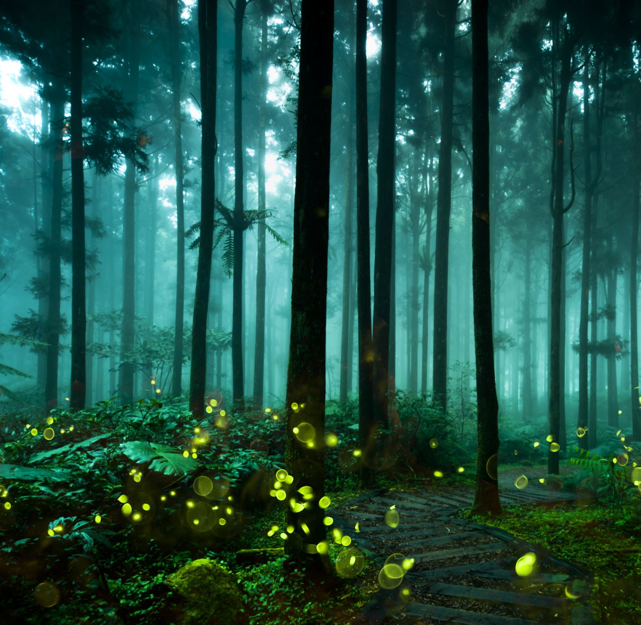
Leśne Skrzaty
Grupa Skrzata Wesołka
Lesson 3 Fun on the Farm!
Nauczyciel : Katarzyna Iwańczyk

Slide 2
Song
Guess the animal?
What`s your name? How old are you?
Look! My animals friends! Hen goes cluck, cluck! Pig goes oink, oink! Dog goes woof, woof!
Horse goes neigh, neigh! Cow goes moo, moo! Rabbit goes boing! Boing!
Rabbits jump! Hens hop! Pigs eat! Horses run! Cows walk! Dogs run!

Slide 3
Can you hear the animal? What it is?
Is it a hen? Or maybe a pig?
Filmik kliknij tutaj

Slide 4
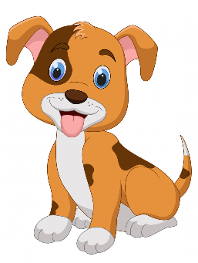
Dog and down
dance

Slide 5
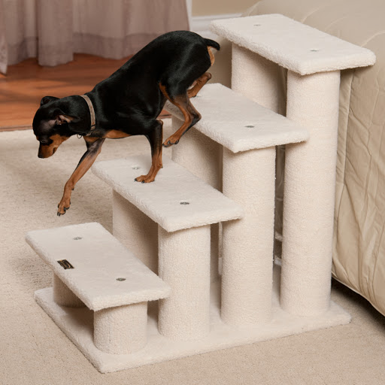
Denny the dog goes down, down, down.
Tongue twister

Slide 6
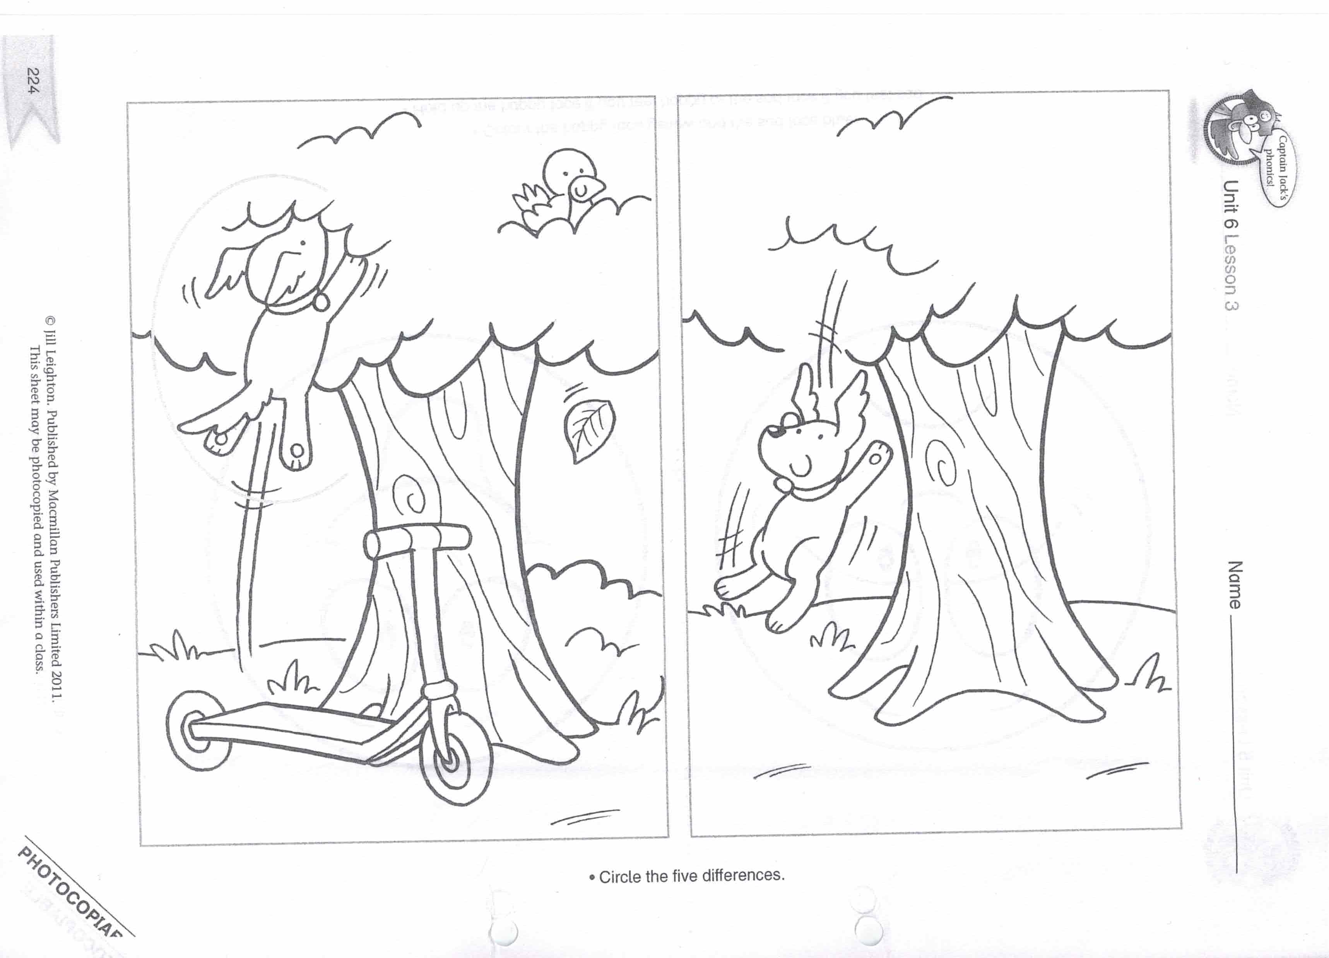
Who`s this? It is a dog!
Is he going up or down?
Is he going down or up?
Circle the difference! Find four more please!
Colour it!
Who`s this
The story song

