Slide 1
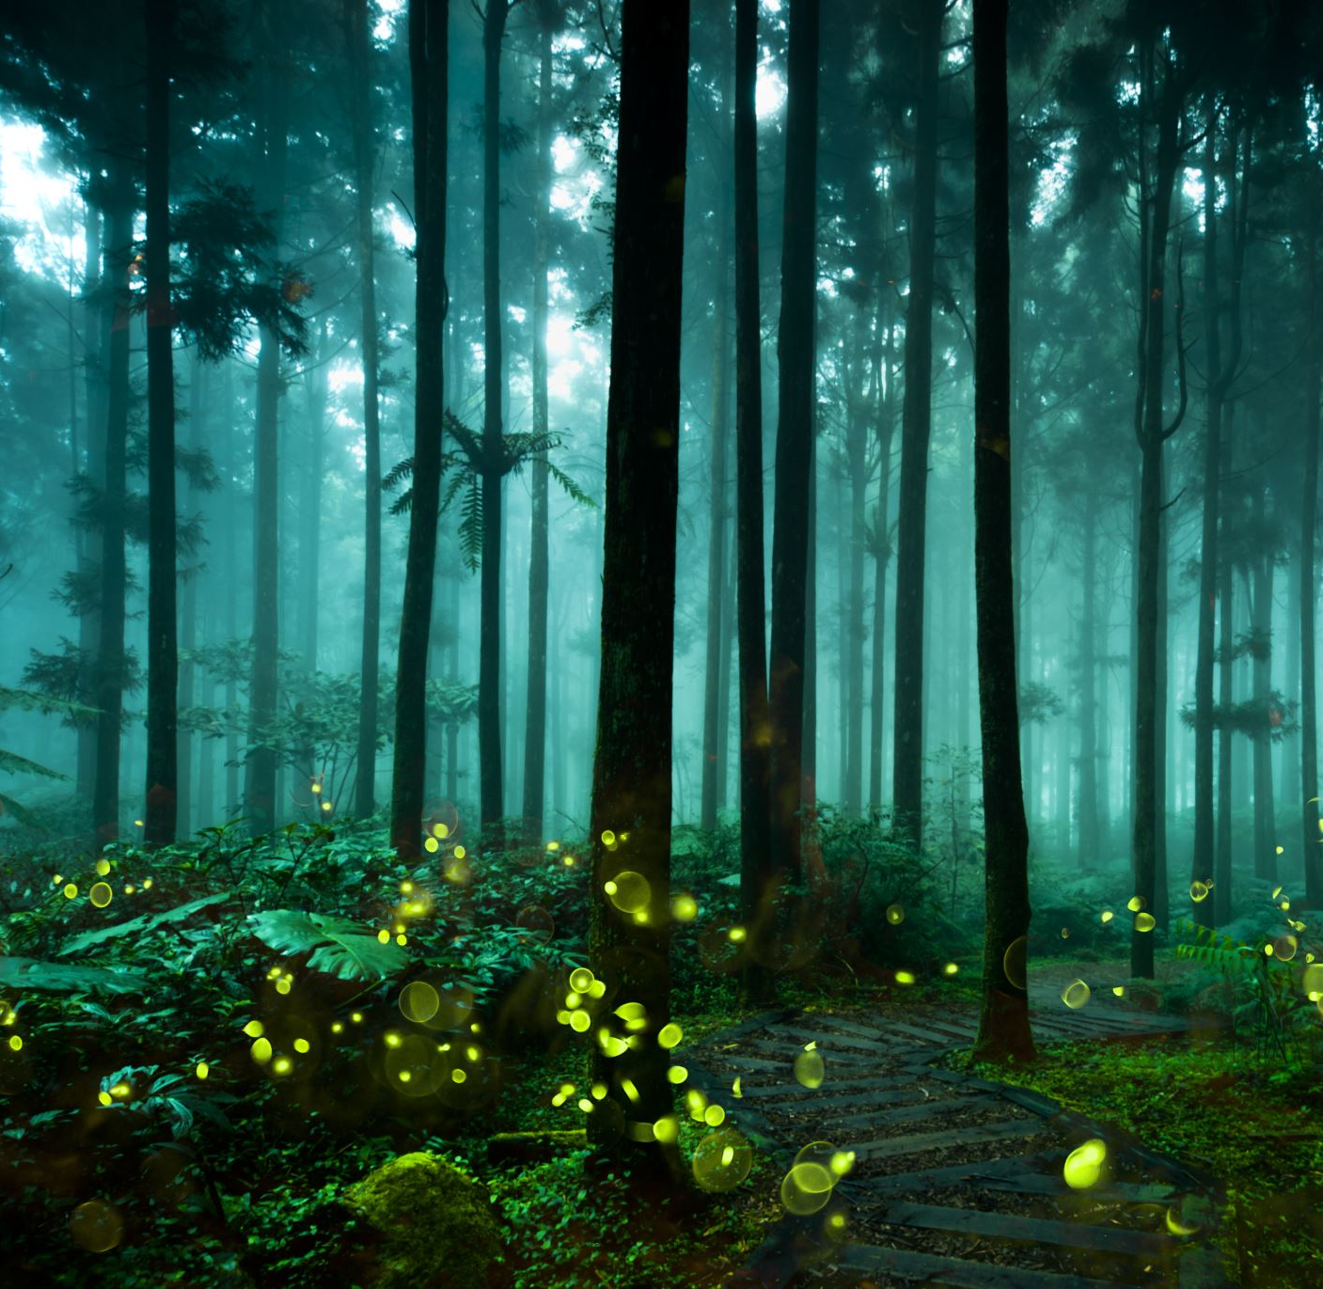
Leśne Skrzaty
Grupa Skrzata Wesołka
Lesson 4 Fun on the Farm!
Nauczyciel : Katarzyna Iwańczyk

Slide 2
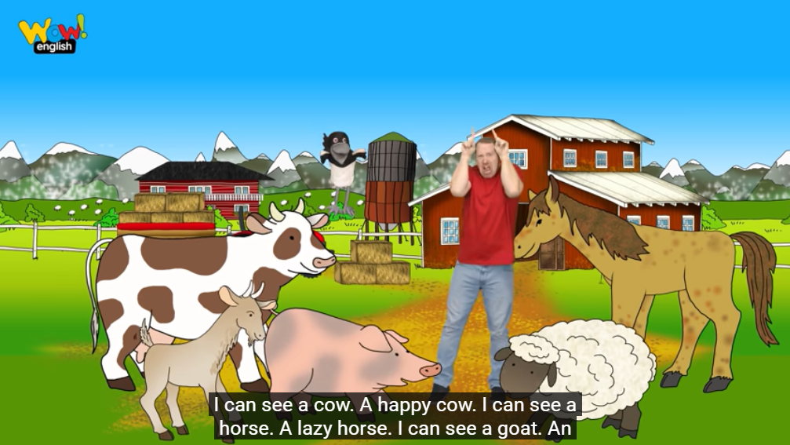
Watch click here
Song

Slide 3
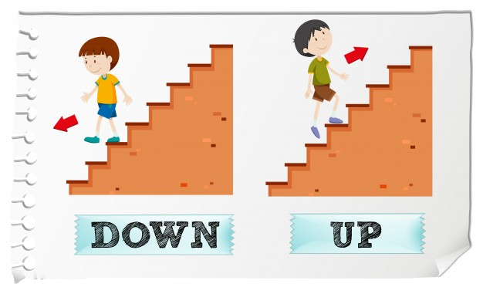

Slide 4
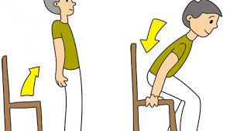
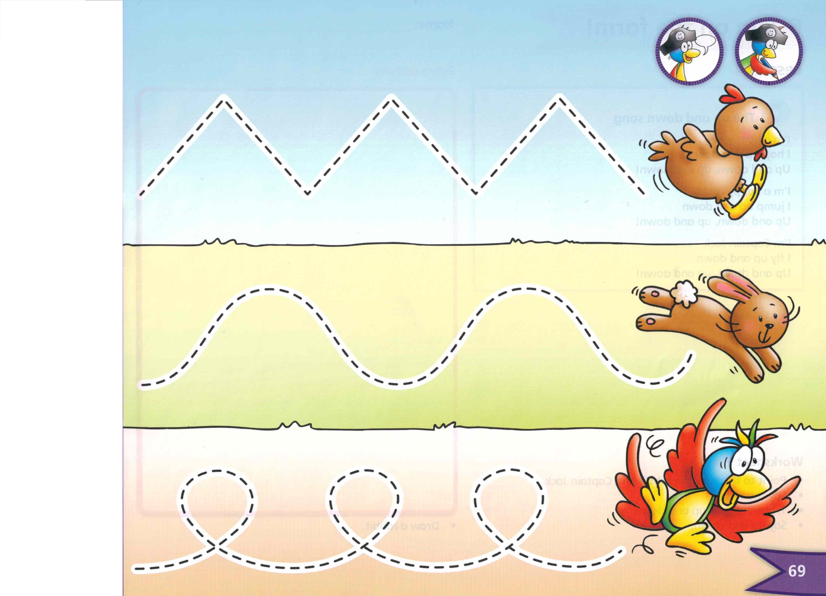
Play up and down!
Hands up! Hands down!
Arms up! Arms down!
Leg up! Leg down!
Head up! Head down!
Jump up! Crouch down!
Stand up! Sit down!

Slide 5
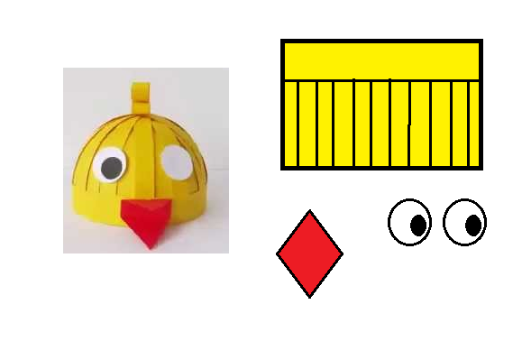
Song
.
Draw a rabbit!

