Slide 1
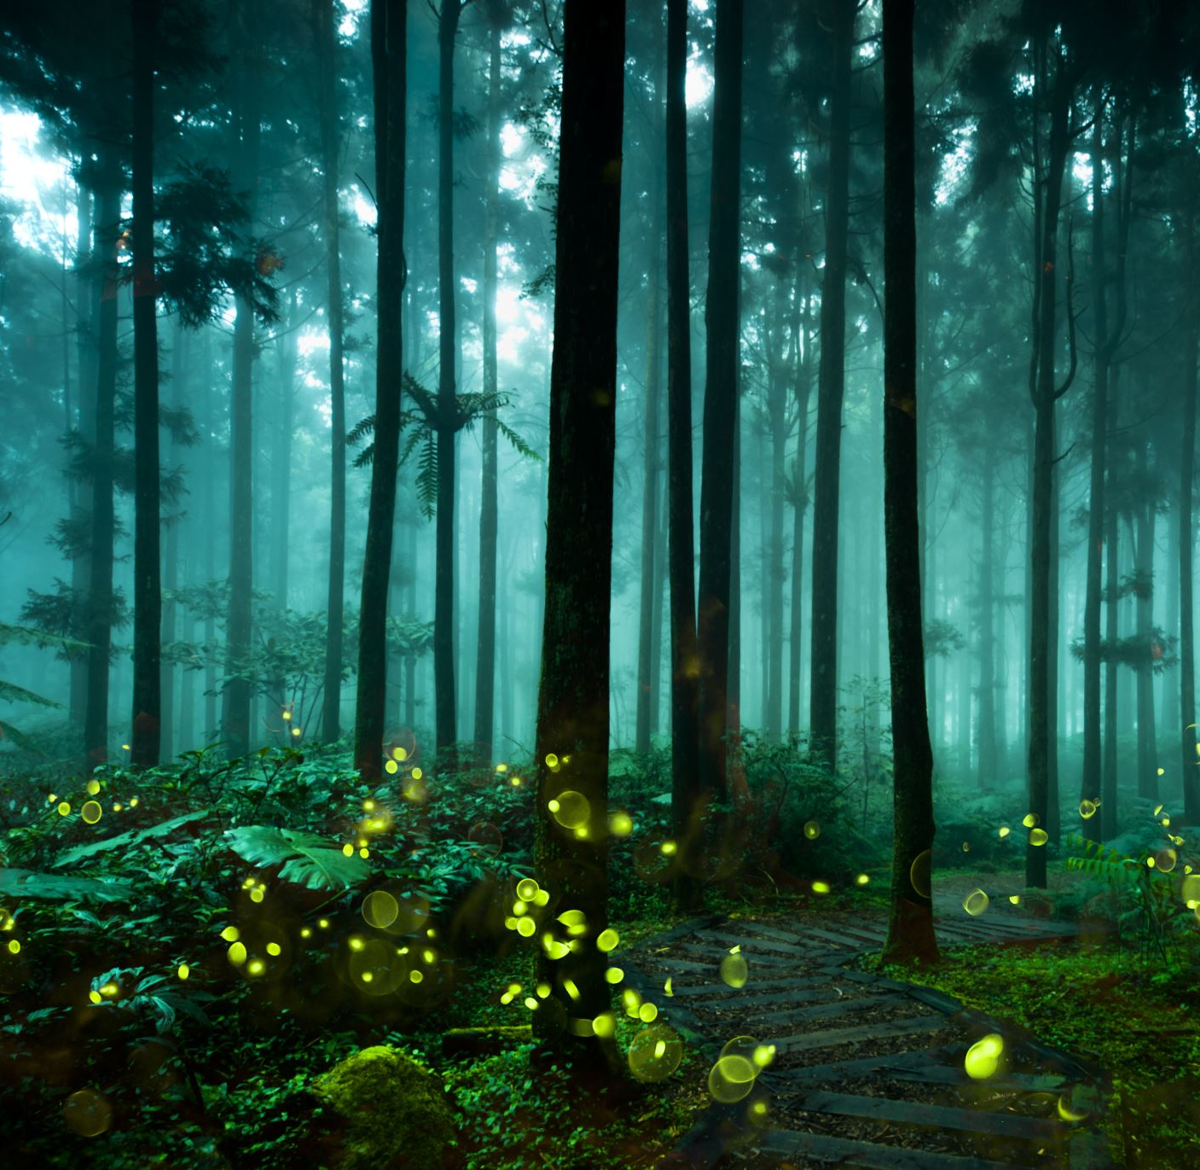
Leśne Skrzaty
Grupa Skrzata Opałki
Lesson 4 The Pram
Nauczyciel : Katarzyna Iwańczyk

Slide 2
Song time
Hello ☺
How are you today?
What`s your name?
How old are you?

Slide 3
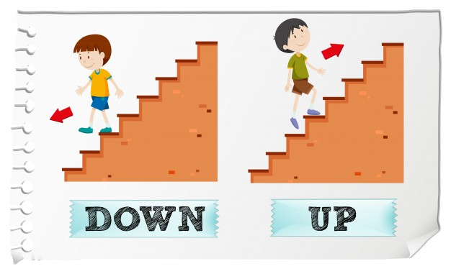
1
2
Story time
3
Up and down game!
Sit down! Stand up!
Hand up! Hand down!
Right Leg up! Right Leg down!
Head up! Head down!
Left Arm up! Right arm down!

Slide 4
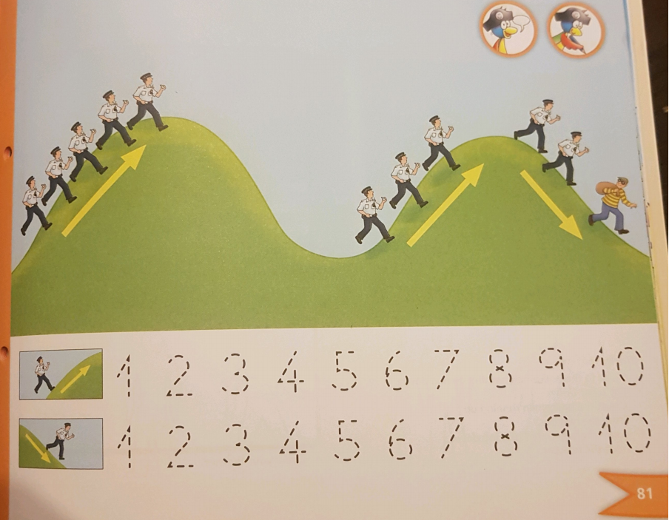
Song time

Slide 5
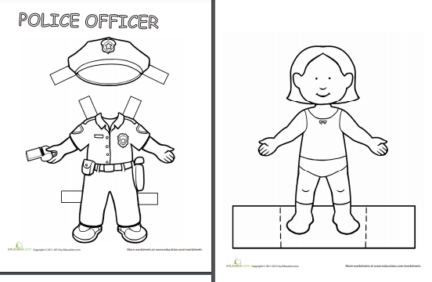
Let`s dress up! Put on your trousers! Put on your shirt! Put on your shoes! Put on your hat! Hello I`m a policeman! Can you help me please?
1
Song time
2
3

